Slide 1
Capsulotomy
Dr. Navin Gupta M.S.
Shankar Netrika Eye Hospital

Slide 2
History
Canopener - Jacques Daviel, 1752
Envelope Technique - Introduced by Sourdilla and Baikuff 1979. Popularised by Galand
Capsulorhexis - Gimbel, Neuhann, Shimizu, 1984

Slide 3
Types
Multipuncture (canopener) capsulotomy
Envelope (inter capsular) capsulotomy
Continuous curvilinear capsulotomy

Slide 4
Terminology
Capsulorhexis - Tear the capsule
Capsulotomy - Cut the capsule
Capsulectomy - Remove the capsule

Slide 5
CAN-OPENER CAPSULOTOMY
DEFINITION - A ragged but circular opening in anterior capsule made by creating multiple punctures

Slide 6
TECHNIQUE
2 mm perforation into anterior chamber at limbus
AC is formed with VE
Cystotome or double bent 26 G needle used
Punctures in anterior capsule made from 6 o’clock position parallel to dilated pupil margin

Slide 7
TECHNIQUE contd..
Proceed in clock wise direction in circular fashion
Removal of circular capsular flap with Kelman Mac Pherson forceps

Slide 10
ADVANTAGES
Easier to learn
Facilitates superior nuclear prolapse
Easier to use in small pupil cases
VE not necessary
Removal of 12 o’clock cortex easier
Easy placement of IOL in sulcus

Slide 11
DISADVANTAGES
Anterior capsular radial tears
High zonular stress
Capsule tags may occlude I/A port
IOL decentration - pea podding
Poor support for PCIOL in PCR

Slide 12
ENVELOPE CAPSULOTOMY
Synonym:- Inter capsular capsulotomy, Linear capsulotomy
DEF : Small incision anterior capsulotomy

Slide 14
Technique
Linear incision made in upper 1/3 rd to middle 1/3 rd of anterior capsule
IOL implanted in the bag
Cuts made at end of incision with vannas
Capsule flap lifted torn off like in capsulorhexis

Slide 16
ADVANTAGE
Minimal tissue trauma
Almost intact capsular bag
Facilitates cortex removal
Polishing of anterior capsule easier
In PC rent - anterior capsule utilised for IOL support

Slide 17
DISADVANTAGES
Asymmetry of capsular flaps
Radial anterior capsular tears to zonules
Unsafe for PHE

Slide 18
Capsulorhexis
Meets the demands of advanced cataract and IOL implantation surgery
Can be reproduced by experienced surgeons
Potential for other developments

Slide 19
Development
North American Development
Howard Gimbel
Europeon Development
Thomas Neuhann
Asian Development
Kimiya Shimizu

Slide 20
Principle & Advantages
Due to lens capsule ‘shearing’ property which resembles a cellophane
1. Endocapsular Phaco possible
2. Limits creating radial tears
3. Hydro dissection more safe
4. Edges of rhexis can stretch and resist damage with energetic maneuvers
5. Zonular stress reduced to minimum and is distributed uniformly along the equator
6. Turbulence (in phaco) is contained better inside the capsule

Slide 21
Advantages…
7. Facilitates cortical aspiration
8. Better IOL centration within the bag placement
9. Capsular bag as Closed system maintaining intracapsular space for surgical maneuvers
10. With PCR , intact anterior capsule provides sulcus IOL implantation possible
11. Minimizes PCO formation

Slide 22
Disadvantages
Difficult learning curve
Limits nucleus prolapse
Not safe in small pupils
Removal of sub incisional cortex difficult
VE necessary

Slide 23
Prerequisites
High microscope magnification
Light beam should be angled – good red reflex
Luminosity must be sufficient
Pupil – maximum mydriasis
Depth of anterior chamber maintained throughout

Slide 24
High molecular weight OVD’s
Capsular opening must respect zonular fibers attachment
Shape and size of capsulotomy must take into account the phacoemulsification technique planned and the size of the IOL

Slide 25
Current standard technique
1. The instrument –
* cystitome / Needle
* Forceps
2. The access - via
* main incision
* side port incision
3. Medium irrigation with - fluid or viscoelastic

Slide 26
Technique
Steps of the procedure:
Initiation of tear
Raising the flap
Gentle extension of the flap curvlinearly
Completion of the rhesis- from outside in

Slide 27
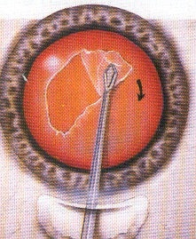
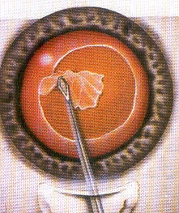
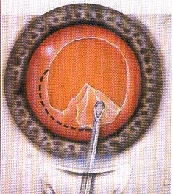
With needle

Slide 28
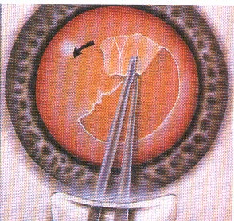
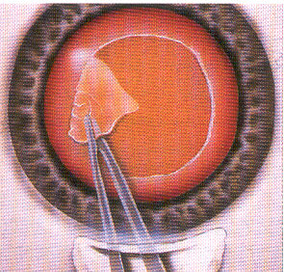
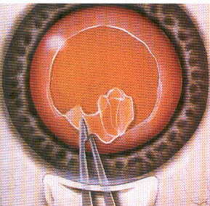
With forceps

Slide 29
CCC with shearing

Slide 30
CCC with Ripping

Slide 31
Ideal size of anterior capsule opening
As large as possible – easy nucleus manipulation
Small enough – “ sealing in ” effect
Limitation to ideal size – size of pupil
Adequate 5 ~ 6 mm
Smaller – problem in phaco ,IOL implantation ,post operative retinal examination difficult , increased chances of capsular phimosis
Larger – nuclear fragments tend to exit from bag
rhexis margin not over optic thus higher incidence of PCO

Slide 32
Fourteen rules of Capsulorhexis
AC chamber well - filled to maintain shape
Use high magnification during the operation
Look for the red reflex
Use high molecular weight OVD’ s (Healon GV , Healon, Provisc)
Operate slowly & carefully

Slide 33
6 Start in the middle with the formation of the flap and continue under the tunnel and then on the remaining 360 degree
7. Complete rhexis from ‘outside in’ rather than inside
8. Repeat capsular grasping several times(at least 4 times ), which means opening by sectors
9. Keep the opening within the limit of the zonular fibers
10. A small rhexis is easier to perform than a large one

Slide 34
11. A small rhexis can be widened at the end of implantation, whereas the large one will tend to escape
12. An irregular rhexis is better than one with a tendency to escape
13. Should the smallest sign of escape appear,use OVD’s of high molecular weight to reform the chamber
14. If problems appear, convert to a different technique to reduce complication

Slide 35
CAPSULOTOMIES IN VARIOUS TYPES OF CATARACTS
PSCC - Capsulorhexis
Posterior polar cataract- capsulorhexis
Mature - Canopener
Hypermature - Envelope
Traumatic - Capsulorhexis, Canopener

Slide 36
CAPSULOTOMIES IN VARIOUS TYPES OF CATARACTS (contd...)
Subluxated lens - Capsulorhexis
Coloboma of iris - Envelope, capsulorhexis
Undilated pupil - Capsulotomy under iris
Spincterotomy
SI

Slide 37
CONCLUSION
CANOPENER
Easy technique
IOL in sulcus
CAPSULORHEXIS
Ideal
Maintains integrity of capsular bag
Absolute in PHE
In the bag fixation of IOL

